Slide 1
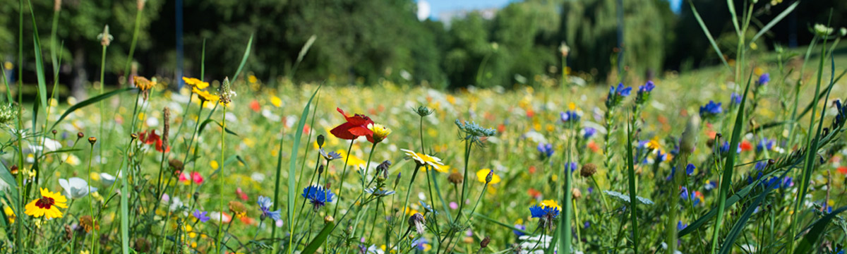

Plants of Poland

Slide 2

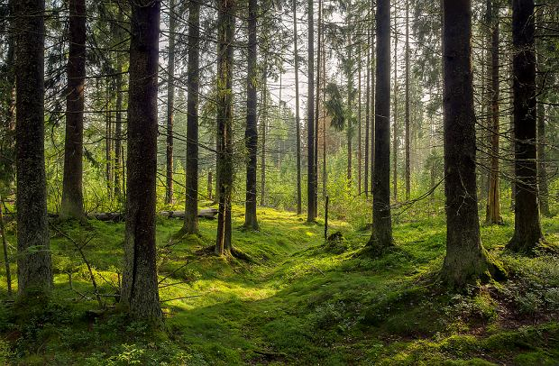
Flora In Poland
Poland is very diverse and rich in flora. There are many plants here that purify the air and please the eye.

Slide 3
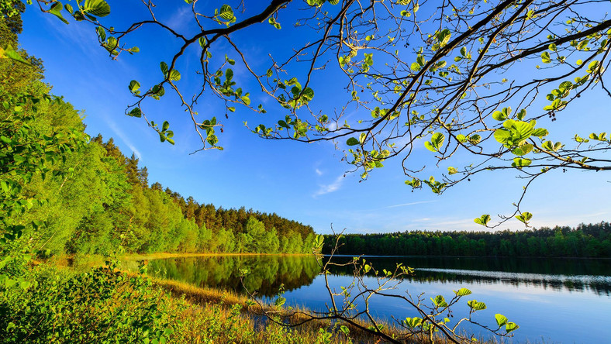
Types Of Forests
In Poland, we divide forests into three types
-mainly coniferous forests
- mixed forests
-deciduous forests

Slide 4
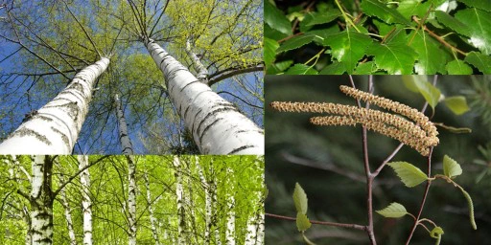
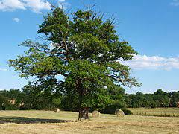
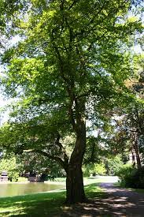
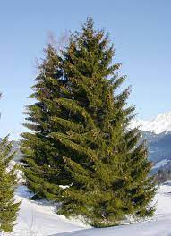
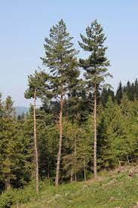
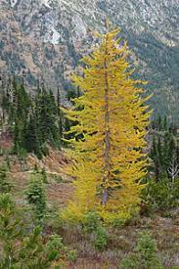
Trees in forest
Birch
Oak
Beech
spruce
pine
larch

Slide 5
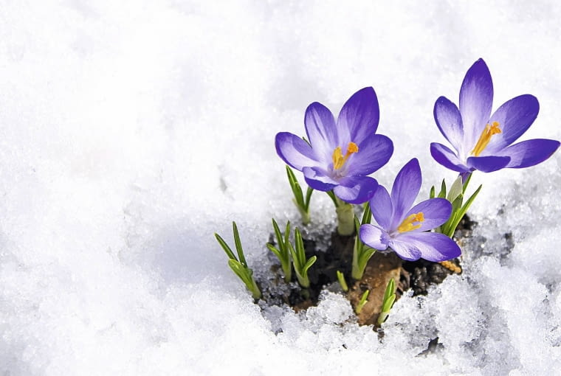
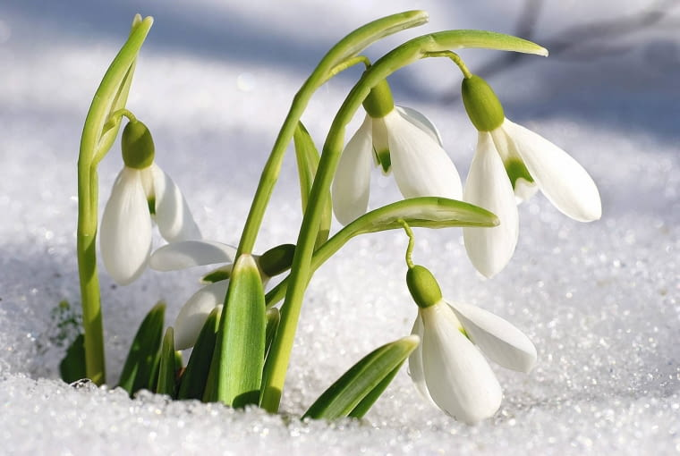
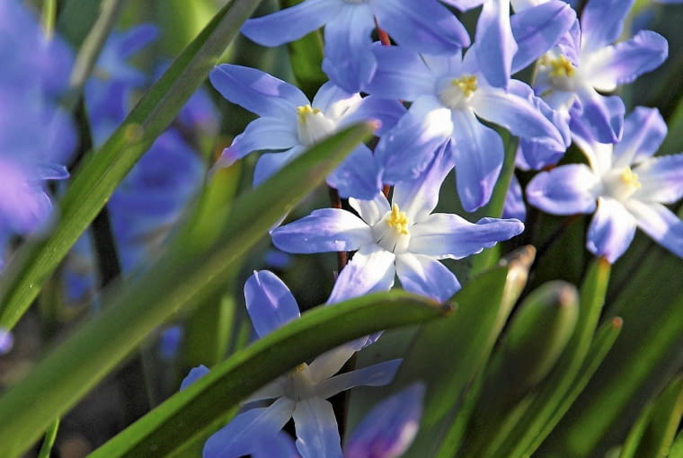
Spring Plants
Spring plants
Krokus
Przebiśnieg
Irys żyłkowany
Crocus
snowdrop
Iris veined

Slide 6
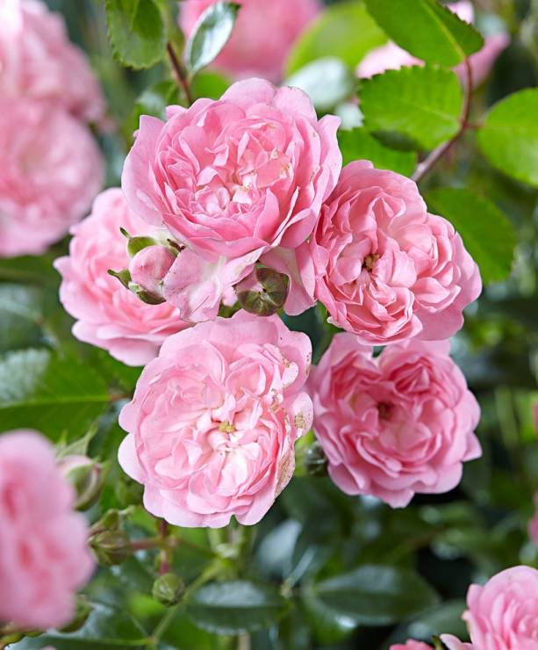
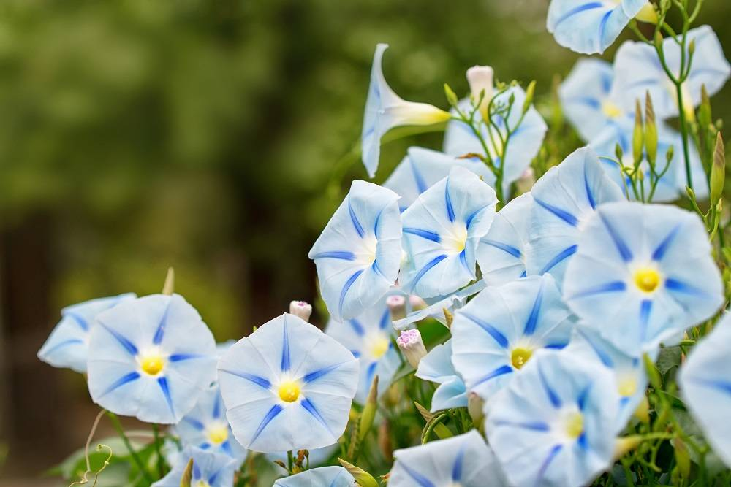
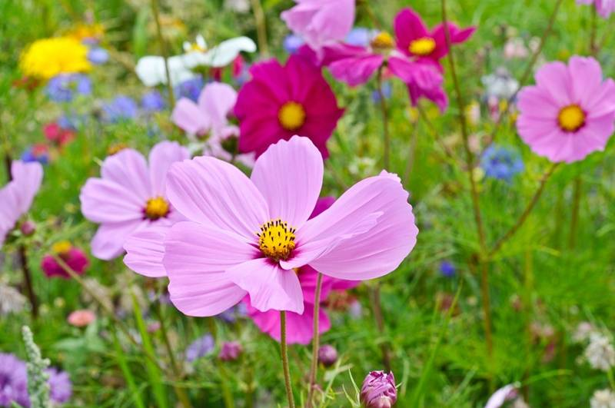
Summer plants
Róża
Wilec trójbarwny
Kosmos onętek
Pink Fairy ground cover rose
0Three-colored wolf
Cosmos of Onetki

Slide 7
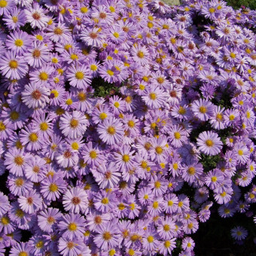
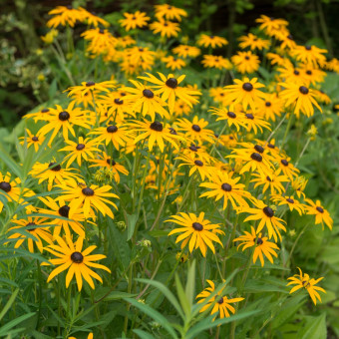
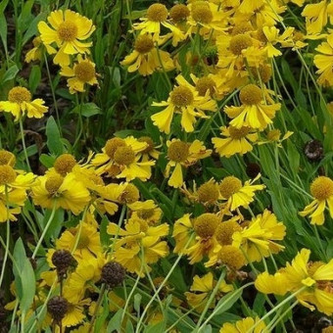
Autumn plants
Astry
Świecąca rubekia Dżielżan ogrodowy
Asters
flashing rudbeckia
pumilum magnificum

Slide 8
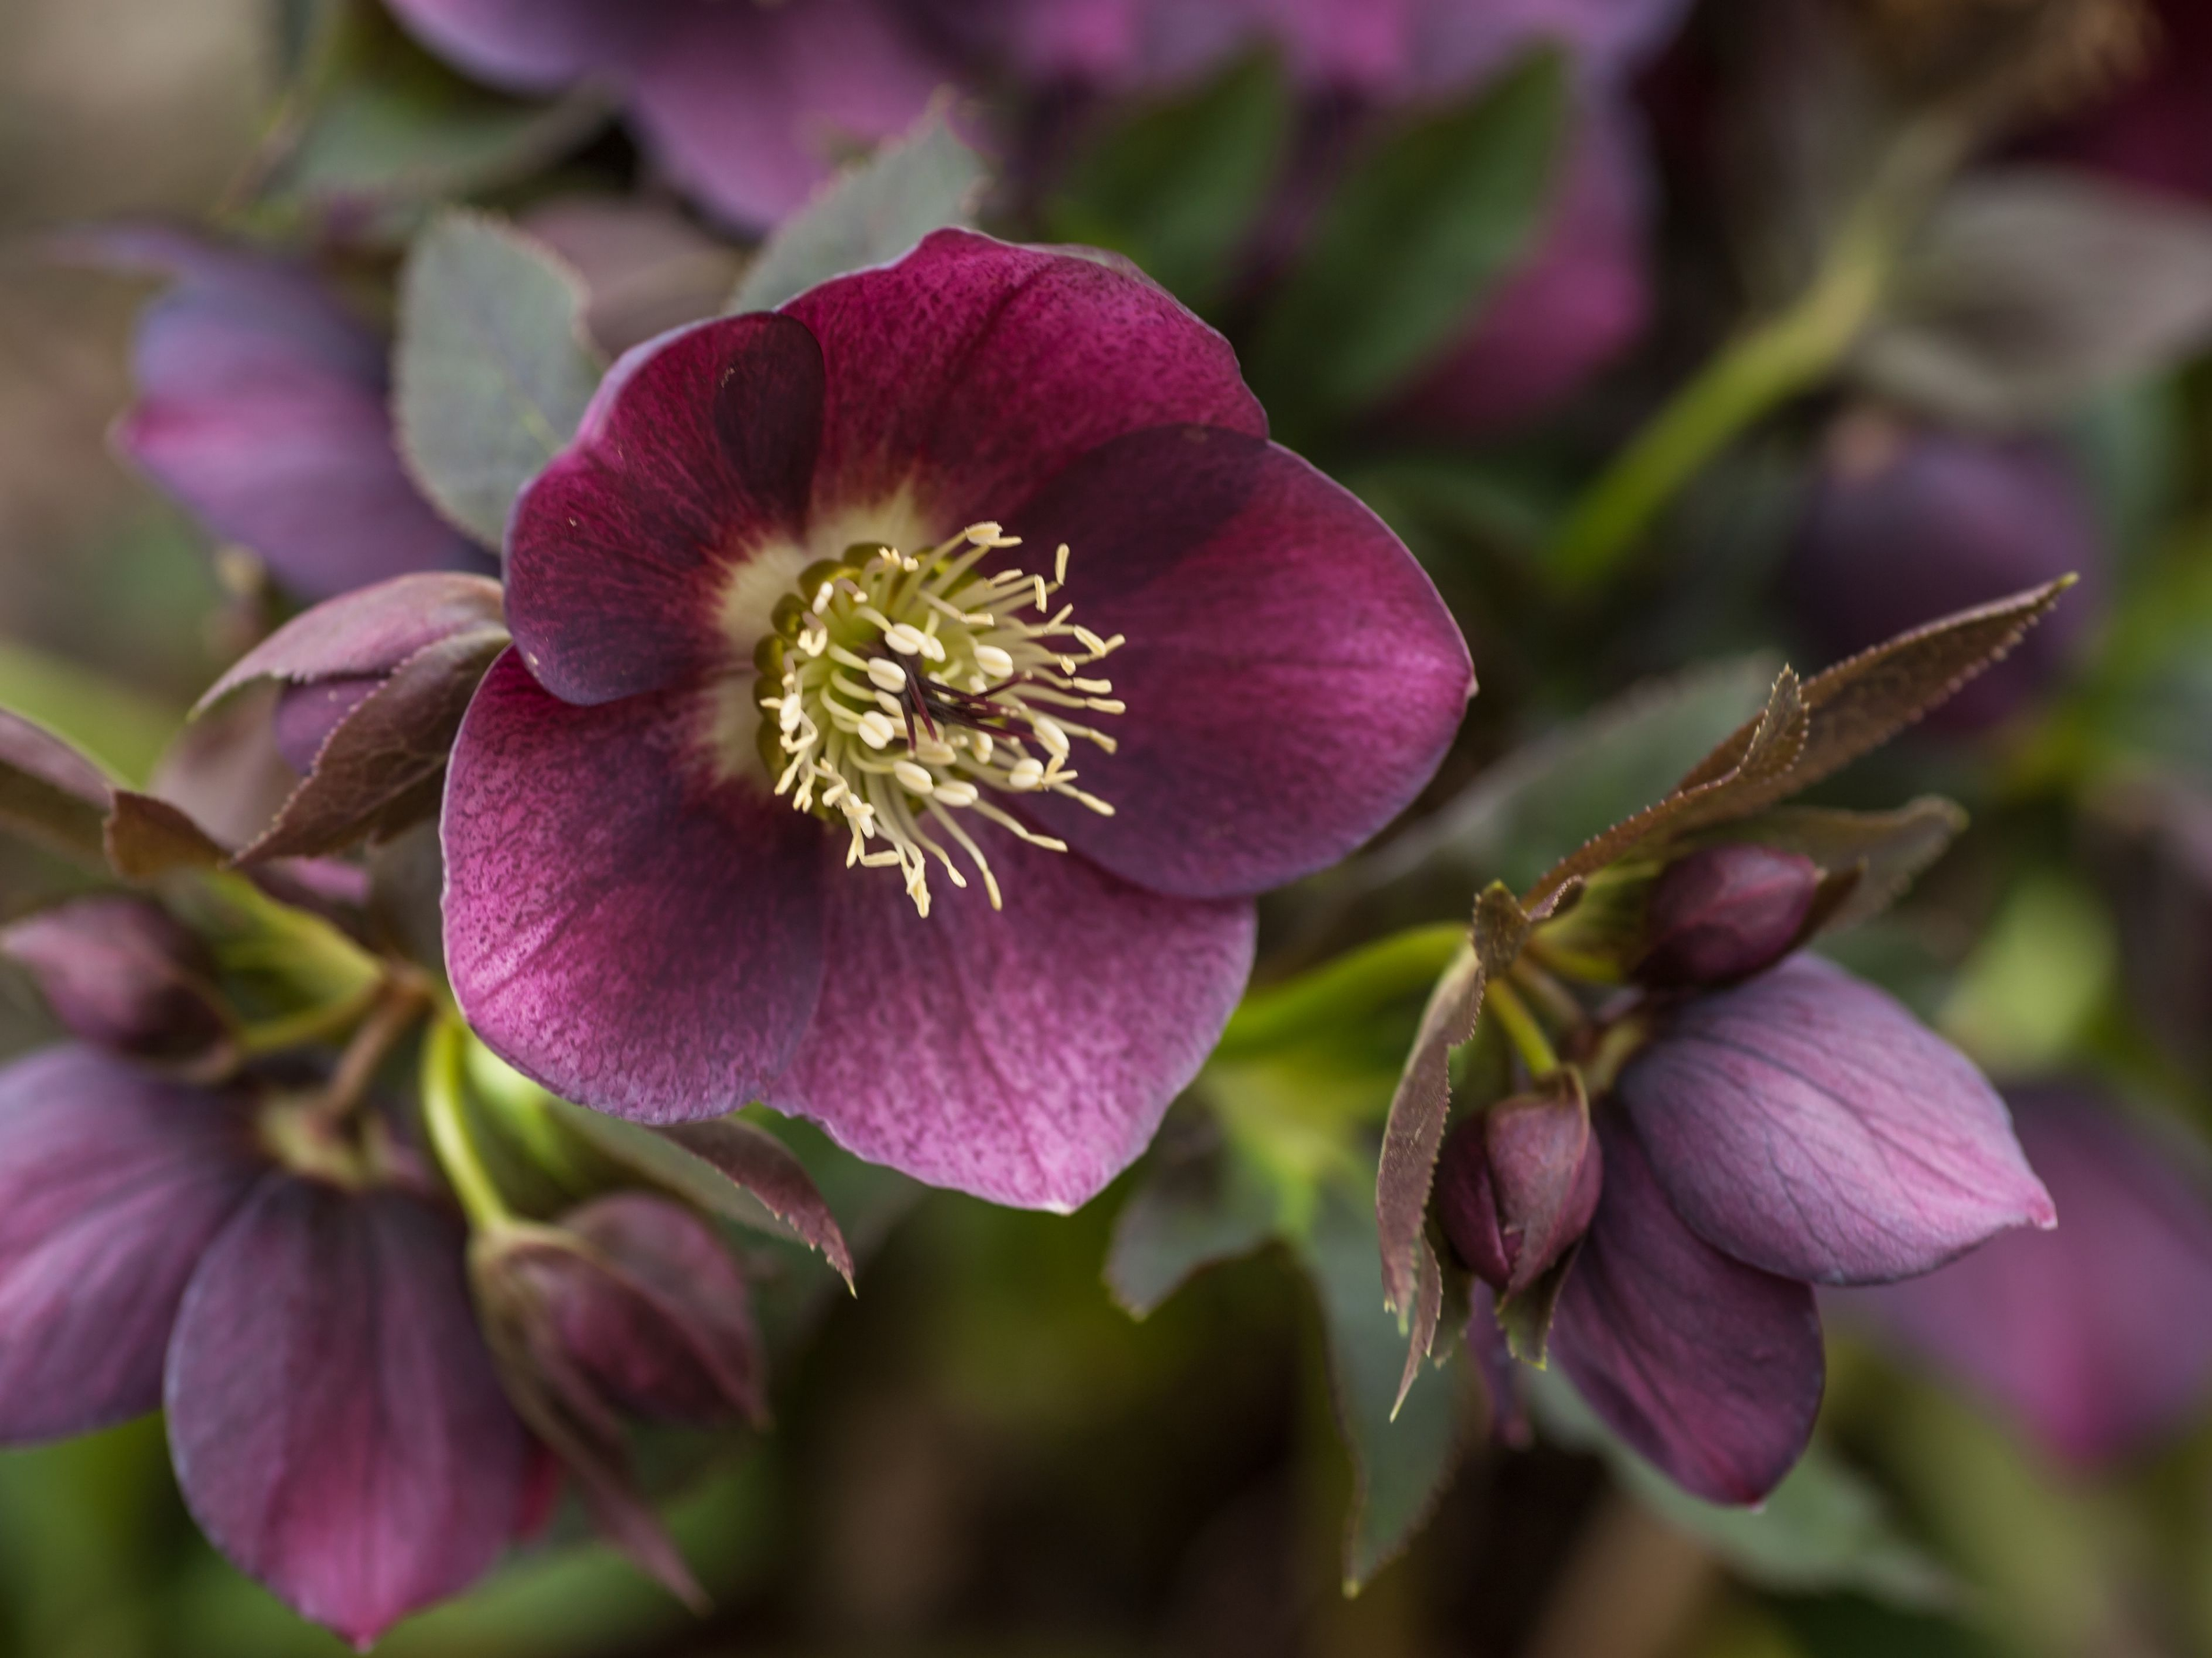
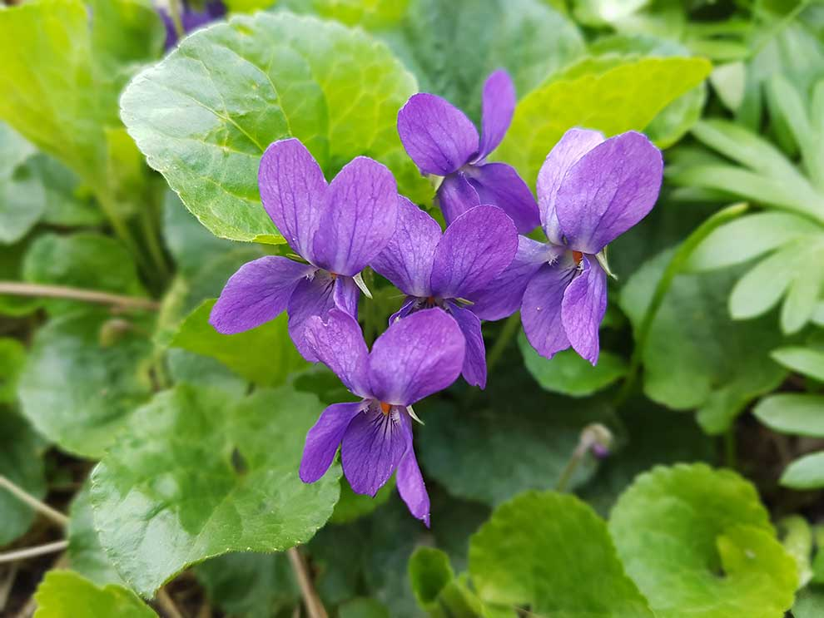
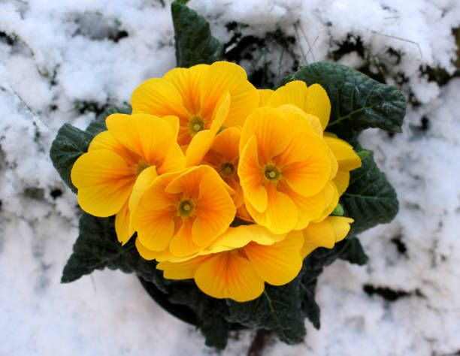
Winter plants
  Early winter flower - Kwiat wczesnej zimy
Hellebore - ciemiernik
Violet - fiołki

Slide 9
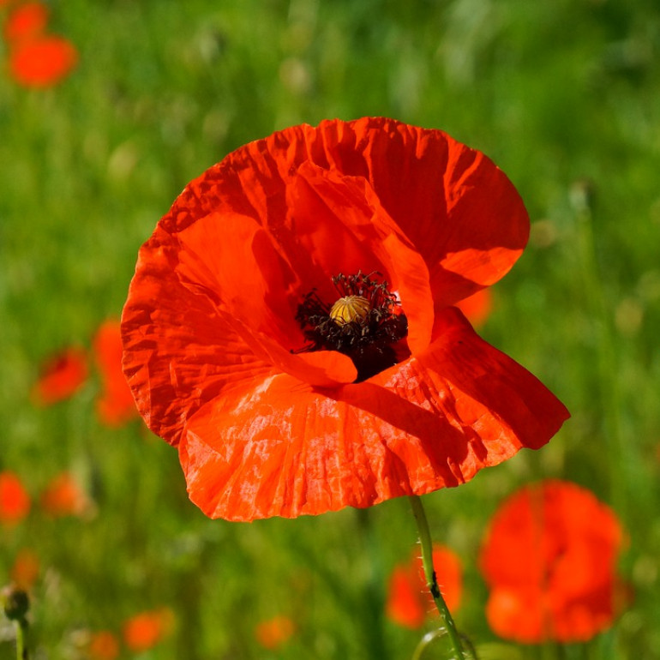
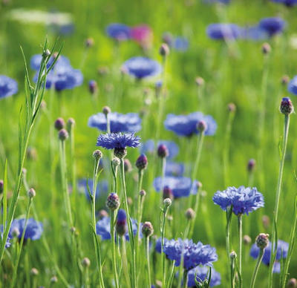
Flowers on fields
Poppy Flower -mak Cornflowers-chabry
Poppy flower

Slide 10
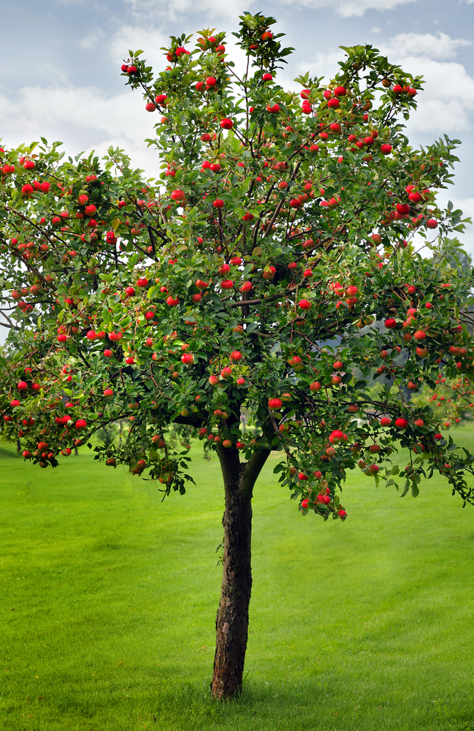
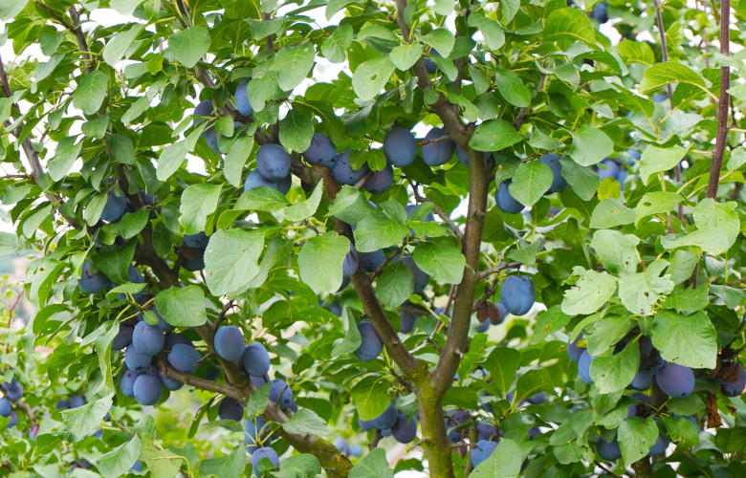
Fruit trees
Many trees and shrubs grow in Poland. They are planted in plantations and in small gardens. The most common are apple trees, plums trees and pear trees.

Slide 11
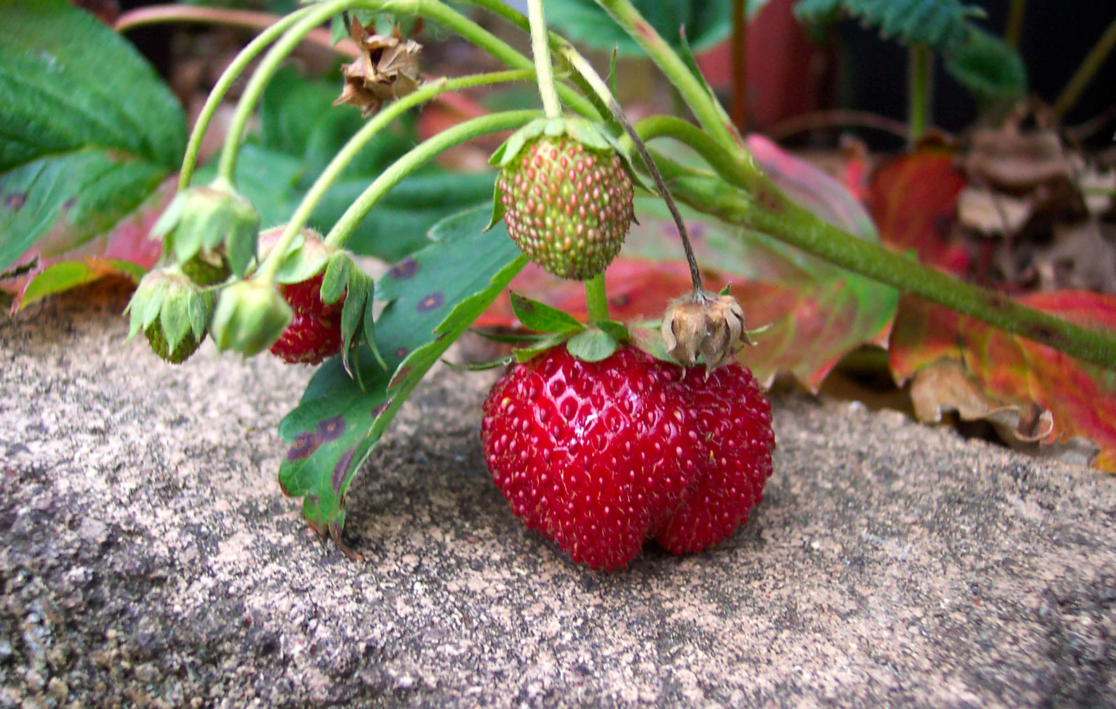
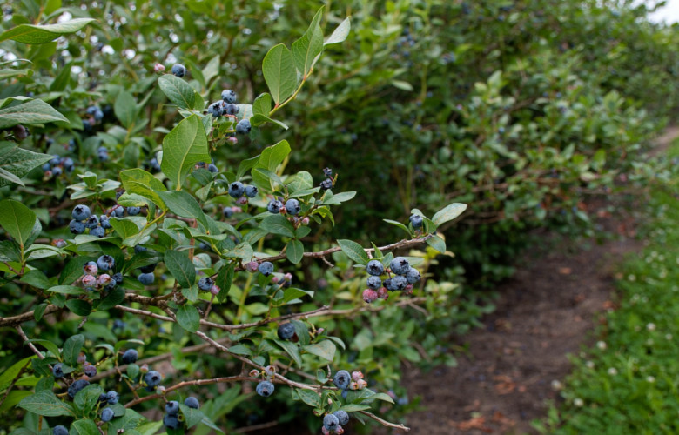
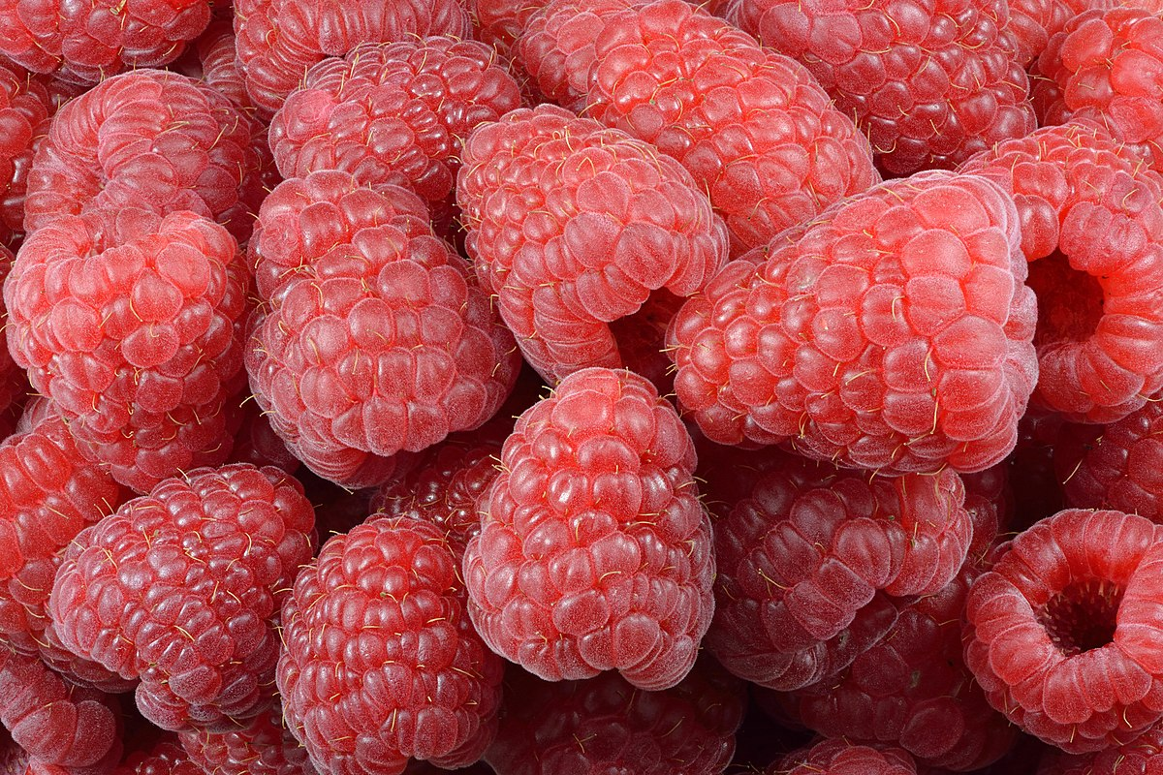
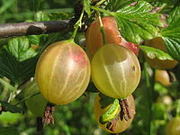
Fruit bushes
Strawberries Blueberries Raspberries Gooseberries

Slide 12
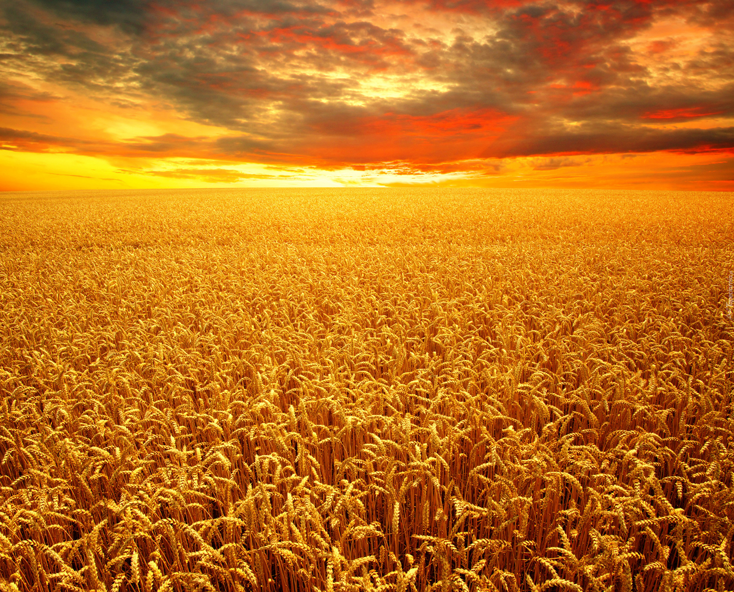
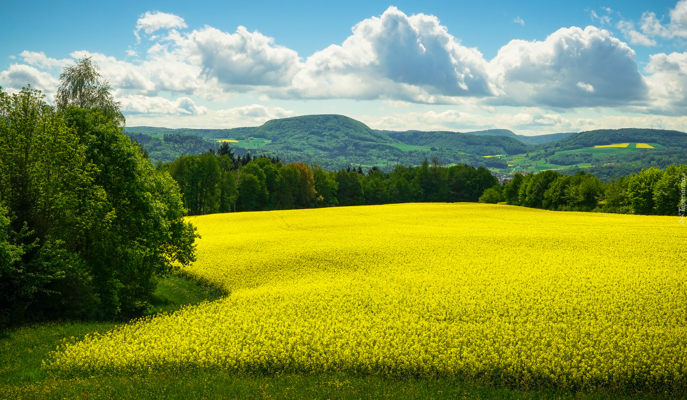
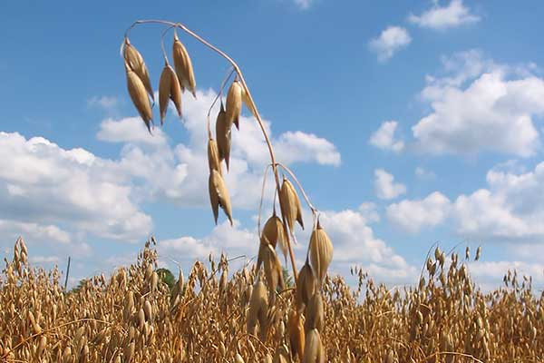
Haverest plants
We often see in Polish fields crops as such as wheat, rye, oats, corn, canola and various vegetables.

Slide 13
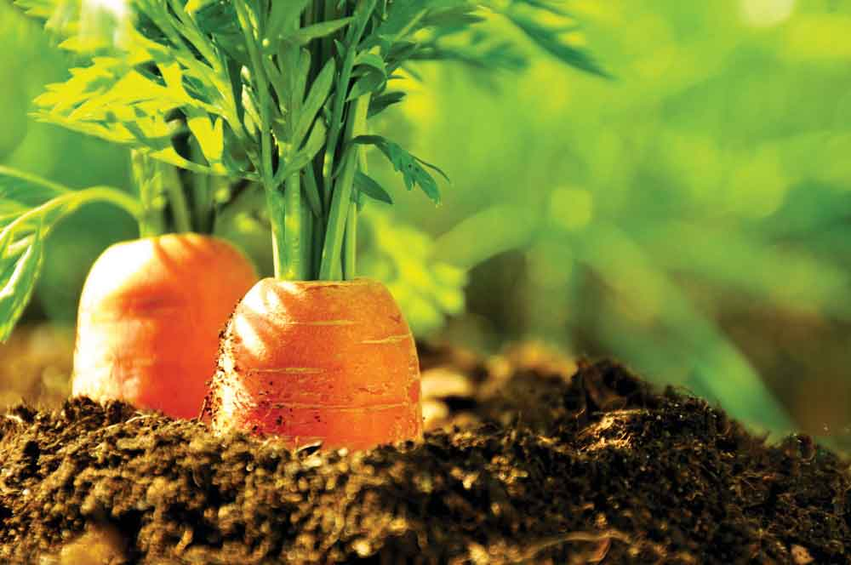

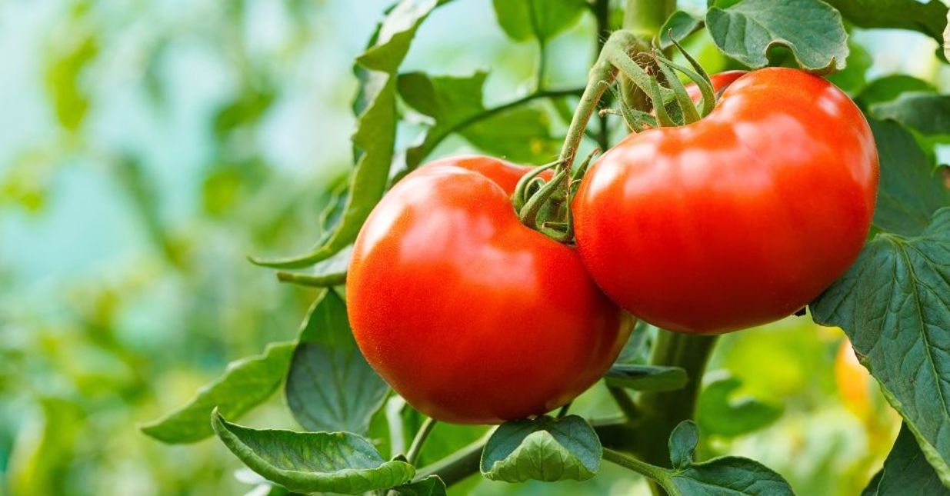
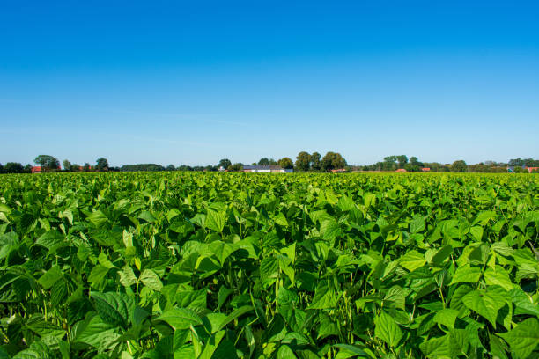
Vegetables
Beetroot, onion, zucchini, lettuce, dill, green beans, carrot, cucumber, tomato and radish are the most commonly grown vegetables in Poland

Slide 14
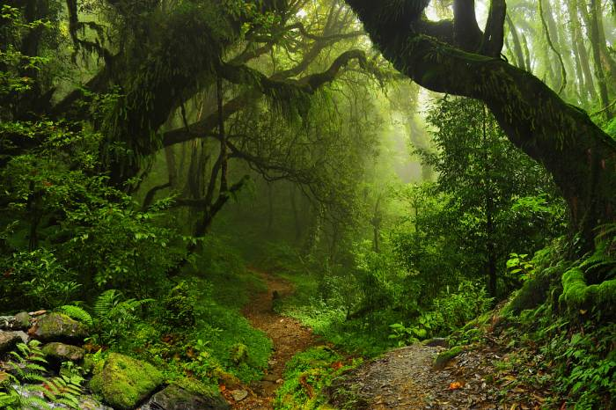
The websites we used:
todeyifoundout.com,
kalendarzrolników.pl,
ladnydom.pl,claudia.pl,sadowniczy.pl
Tapeciarnia.pl
,medianauka.pl,
forofiliki.pl,
puhagromix.pl,
zielonyogodek.pl,
istockphoto.pl,
target.com.pl,
laka.org,
dekowizja.pl,
zdrowie.gazeta.pl,
Podróże.onet.pl
,igipz,pan.pl,
wikipedia.org,
Rck.org.pl
fajnyogród.pl

Slide 15
The End
Thank you for your attention!
The presentation was prepared by Oliwia Olbrys and Łucja Kosider

