Slide 1
Art in poland

Slide 2
This term covers artistic activity in areas related to the Polish state from prehistory to the present day. since the creation of the state, art was shaped primarily in the Western (Latin) culture, from the late Middle Ages in the eastern territories. Apart from Poles, European artists played an important role in Polish art, especially in the Middle Ages and modern times.

Slide 3

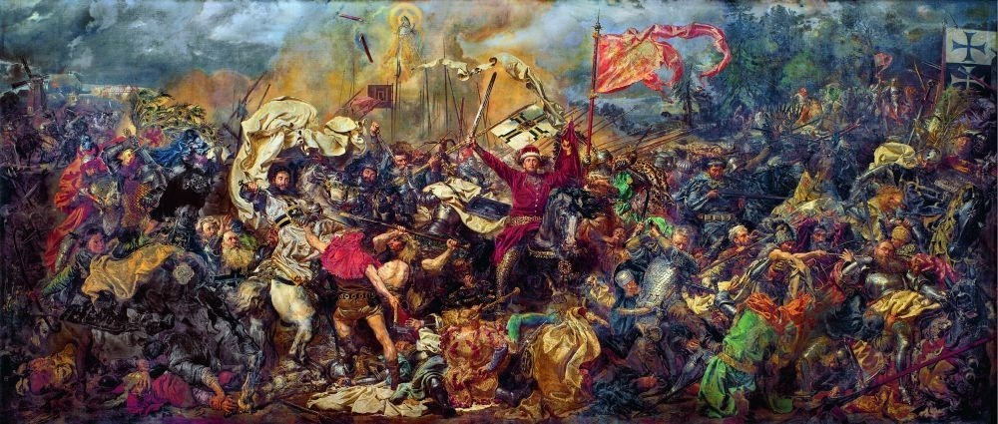
PAINTING
The beginnings of painting in Poland are connected, as in the general beginnings of Polish art, with the adoption of Christianity from Rome in 966, which made Polish culture a part of the rich and vivid Western European tradition.
Jan Matejko — "Bitwa pod Grunwaldem"

Slide 4
THE ERAS OF PAINTING
PREHISTORY
ANTIQUITY
MIDDLE AGES
RENAISSANCE
MANNERISM AND BAROQUE
ROCOCO
CLASSICISM
ROMANTICISM
REALISM
SYMBOLISM AND PRERAFAELICS
IMPRESSIONISM
EXPRESSIONISM, PHOVISM AND POSTIMPRESSIONISM
CUBISM AND ABSTRACTIONISM
SURREALISM AND DADAISM

Slide 5
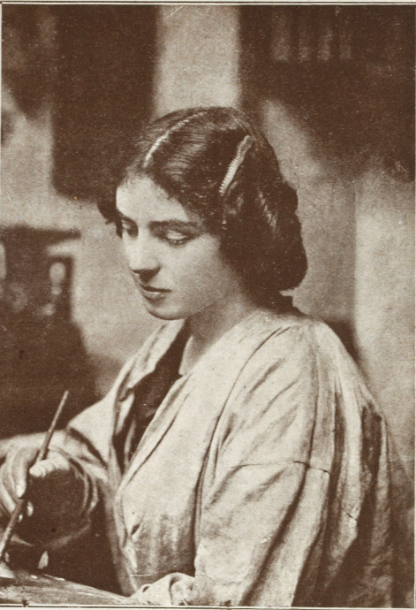
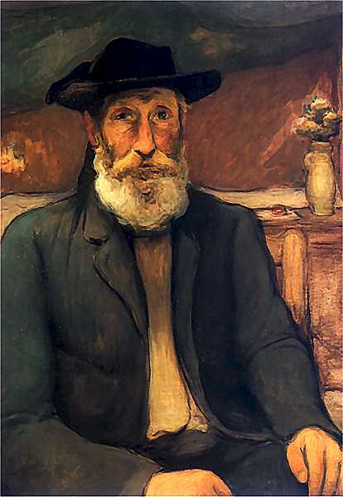
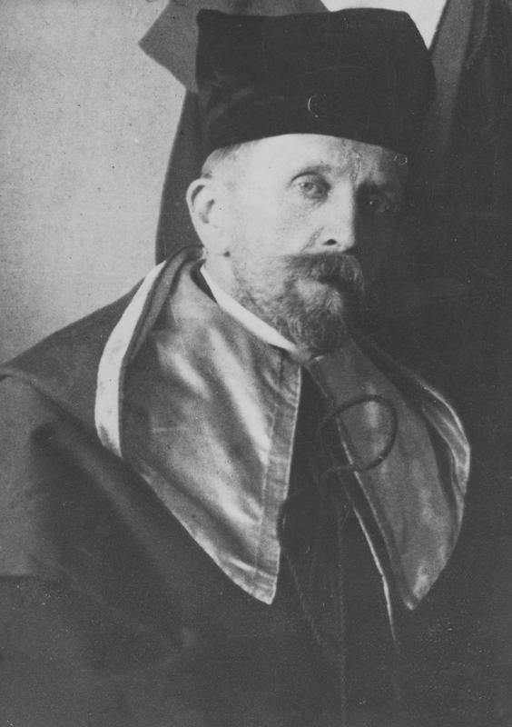
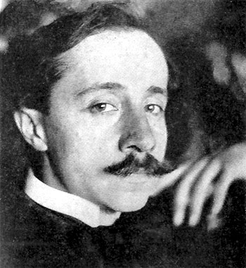
POLISH PAINTERS
Wojciech Weiss
Ferdynand Ruszczyc
Ferdynand Ruszczyc
Mela Muter
Władysław Ślewiński
Ferdynand Ruszczyc
Wojciech Weiss

Slide 6
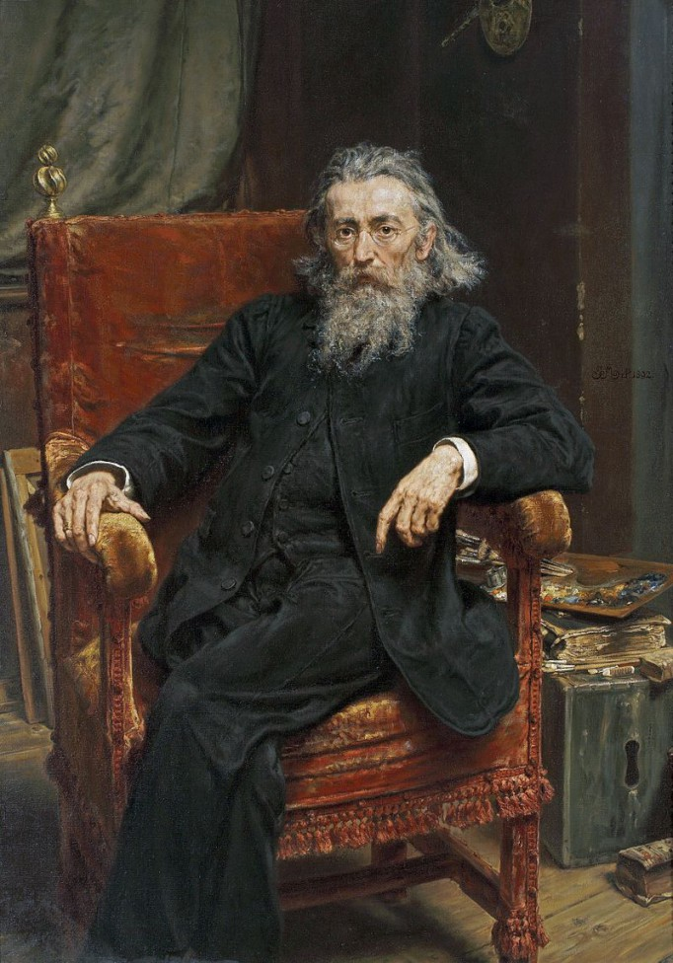
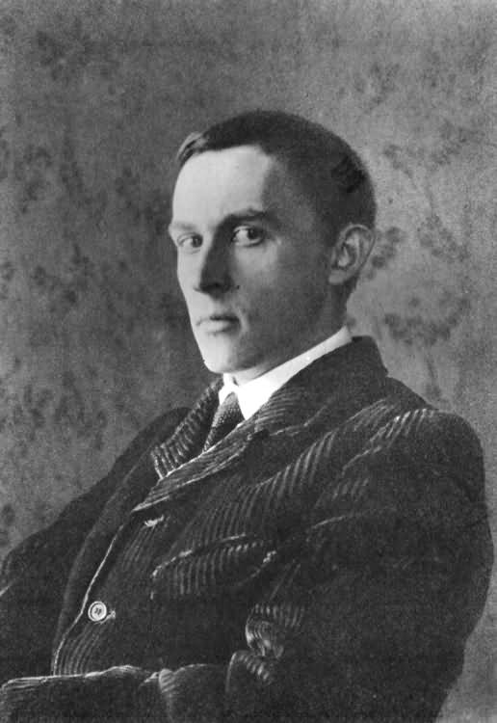
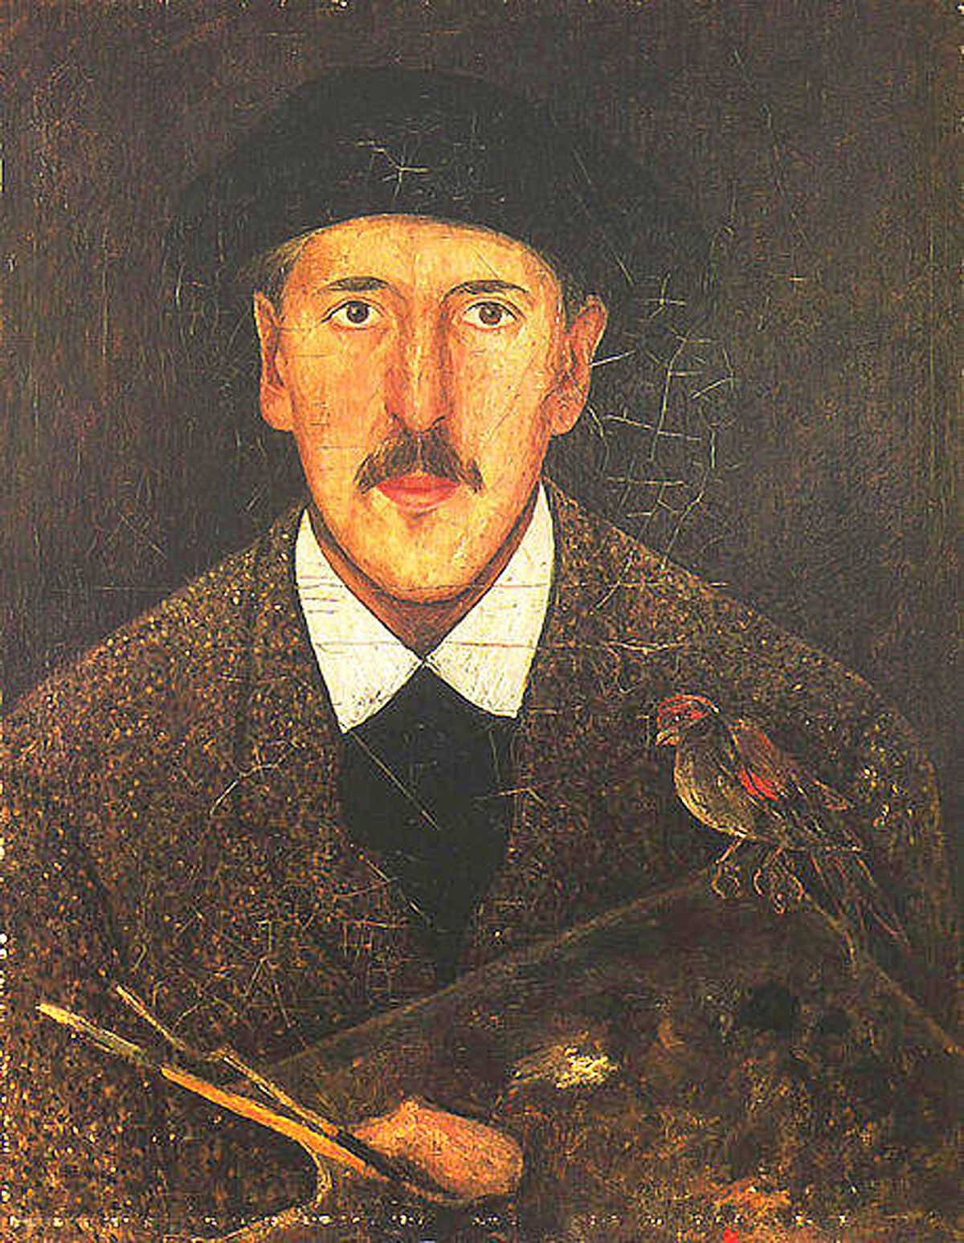
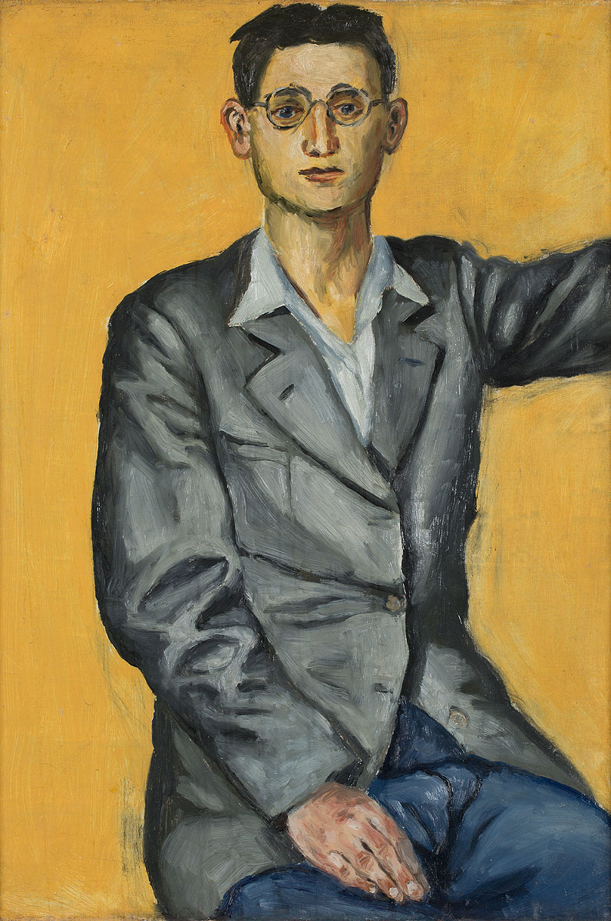
...AND MORE POLISH PAINTERS
Stanisław Ignacy Witkiewicz
Tadeusz Makowski
Andrzej Wróblewski
Jan Matejko

Slide 7
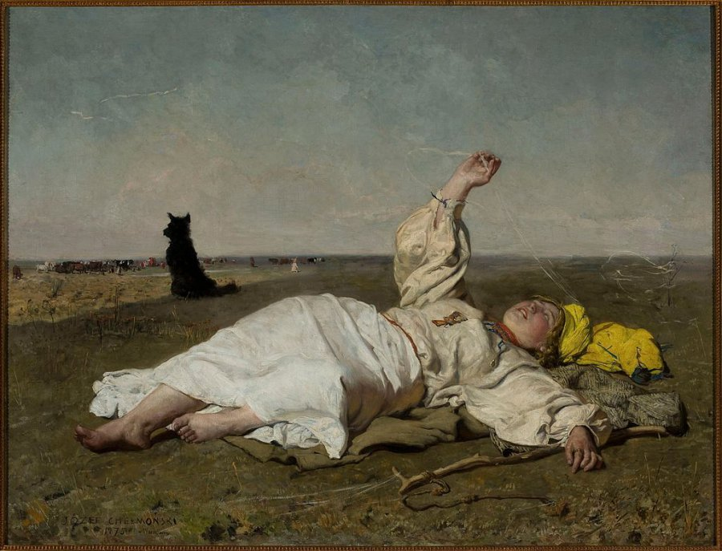
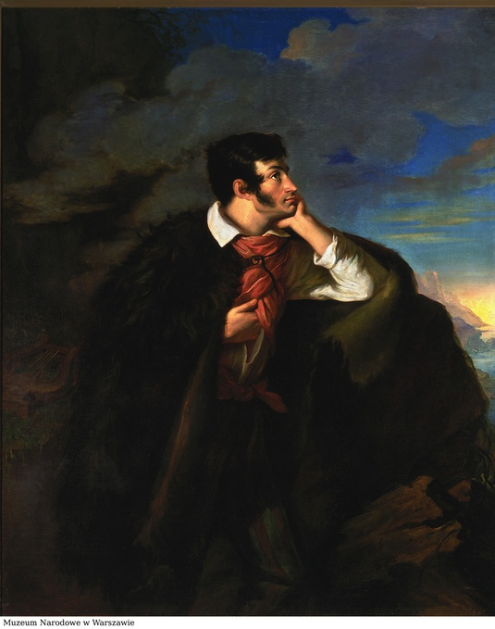
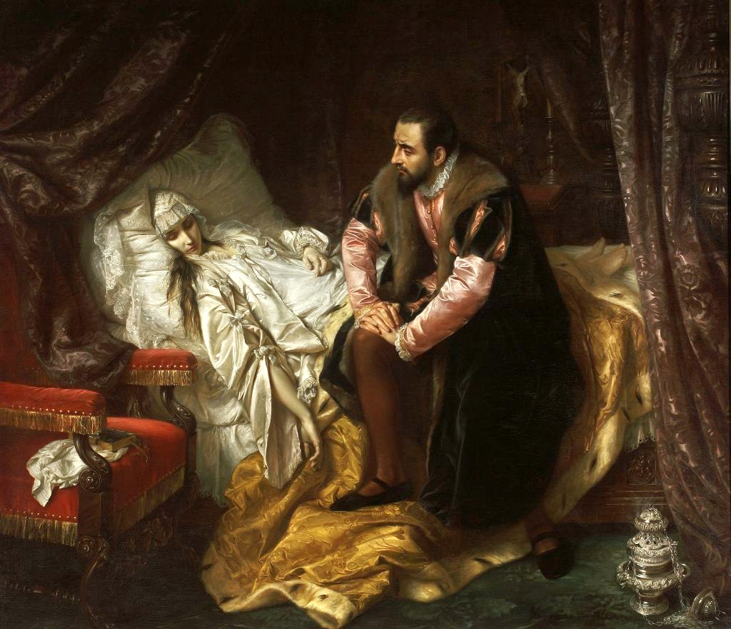
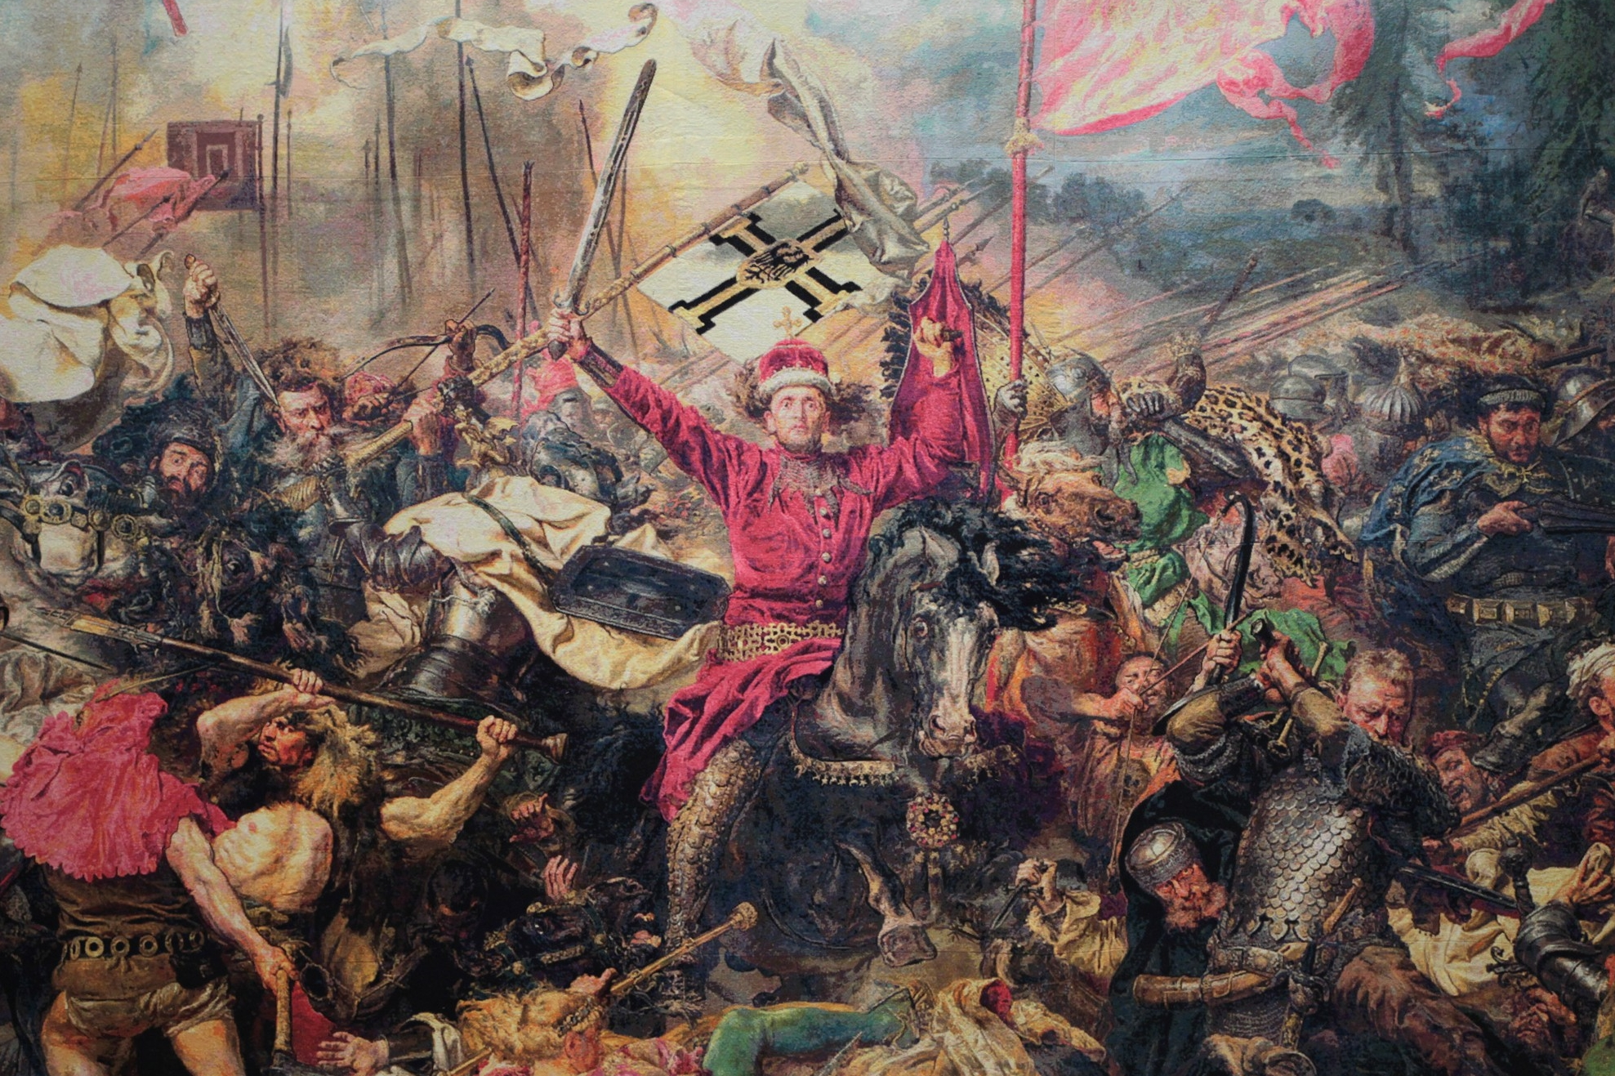
MOST IMPORTANT WORKS
Babie lato (Indian summer) – Józef Chełmoński
Portret Adama Mickiewicza na Judahu skale (Portrait of Adam Mickiewicz on Judah rock) – Walenty Wańkowicz
Śmierć Barbary Radziwiłłówny (The death of Barbara Radziwiłłówna) – Józef Simmler
Bitwa pod Grunwaldem (Battle of Grunwald) – Jan Matejko

Slide 8
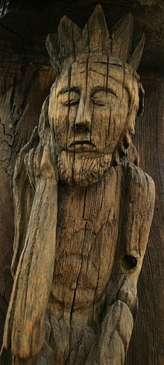
Sculptures
Sculpture -is the oldest field of folk art. It was born in the 16th century. Despite its distinctiveness, folk sculpture was influenced by historical styles, mainly Gothic, Renaissance and Baroque.
Chrystus Frasobliwy, Ethnographic Museum in Krakow

Slide 9
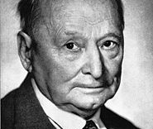
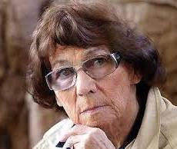
SCULPTORS
  Marta Magdalena Abakanowicz-Kosmowska
  Xawery Dunikowski

Slide 10
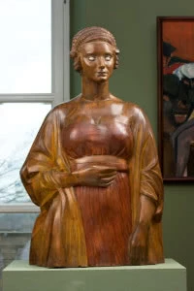
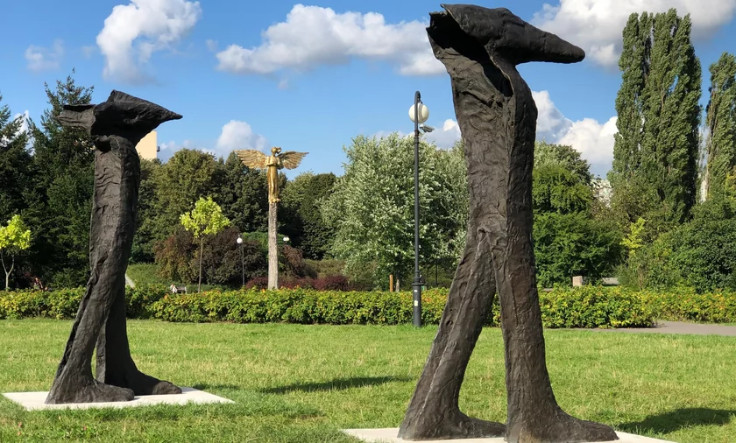
SCULPTURES IN POLAND
Monument Jana Pawła II – in salt mine „Wieliczka”
“Przechodzący przez rzekę”
„Zinaxin” and „Dolacin” by Marta Magdalena Abakanowicz-Kosmowska
Xawery Dunikowski ,,Amerykanka II''

Slide 11
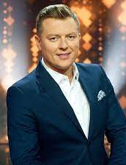
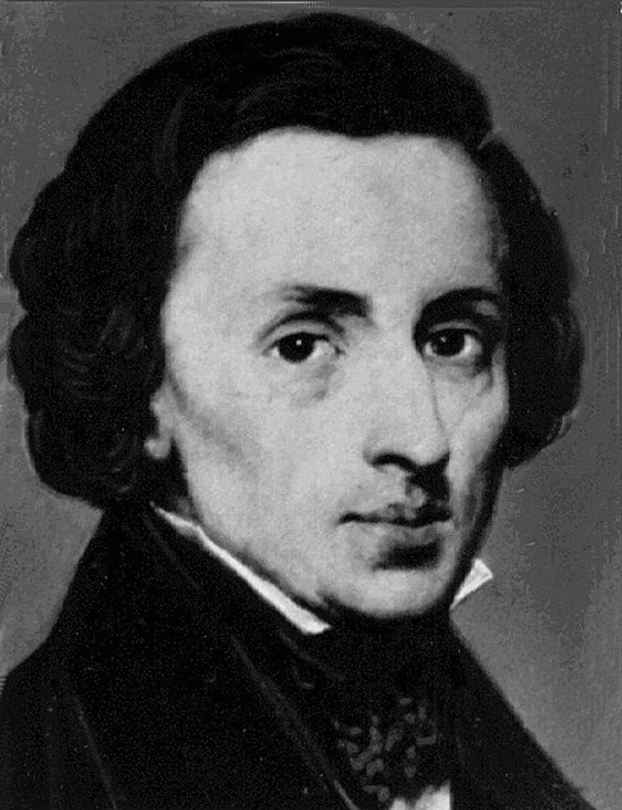

Music
The history of Polish music covers epochs from the Middle Ages to modern times

Slide 12
THE ERAS OF MUSIC
ANTIQUITY
MIDDLE AGES
RENAISSANCE
BAROQUE
CLASSICISM
ROMANTICISM
CONTEMPORARY MUSIC

Slide 13
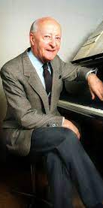
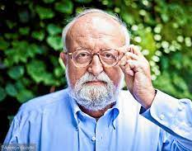
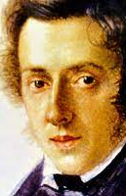
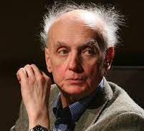
POLISH MUSICIANS
Fryderyk Chopin
Krzysztof Penderecki
Wojciech Kilar
Witold Lutosławski
Modern musicians:
Dawid Kwiatkowski
Rafał Brzozowski

Slide 14
FRYDERYK CHOPIN
Fryderyk Chopin is a Polish composer and pianist.

Slide 15

Thank you for your attention

